Slide 1
Shopping cart using string control
2016741050 정우제
2016741029 이명재
2016741057 이민호
2016741069 정현아

Slide 2
Index
1. Client
2. Problem
3. Motivation & Solution
4. Hardware
5. Team & Schedule

Slide 3
Client

Slide 4



Client
professor
team
company

Slide 5
Problem

Slide 6

Problem
Difficulty in carrying uphill
We found that it is difficult for aged man to go uphill with their shopping carts.

Slide 7
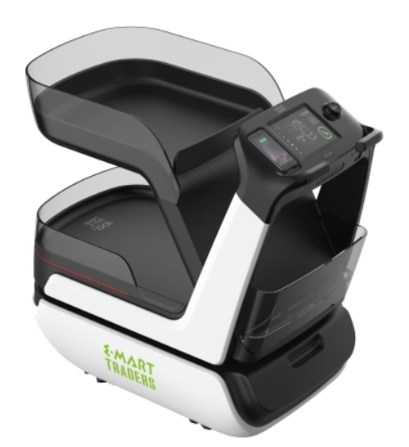
Autonomous cart Eli
Poor recognition
It takes quite a time to recognize user at first.
Confusion of user perception
There is a case where a consumer of a similar dress does not recognize it when it passes by.

Slide 8
Motivation & Solution

Slide 9
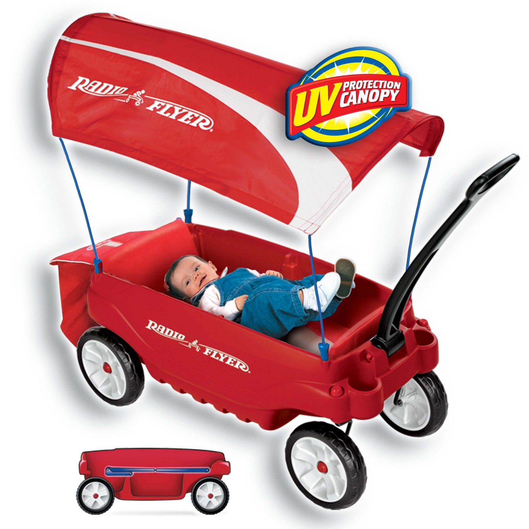
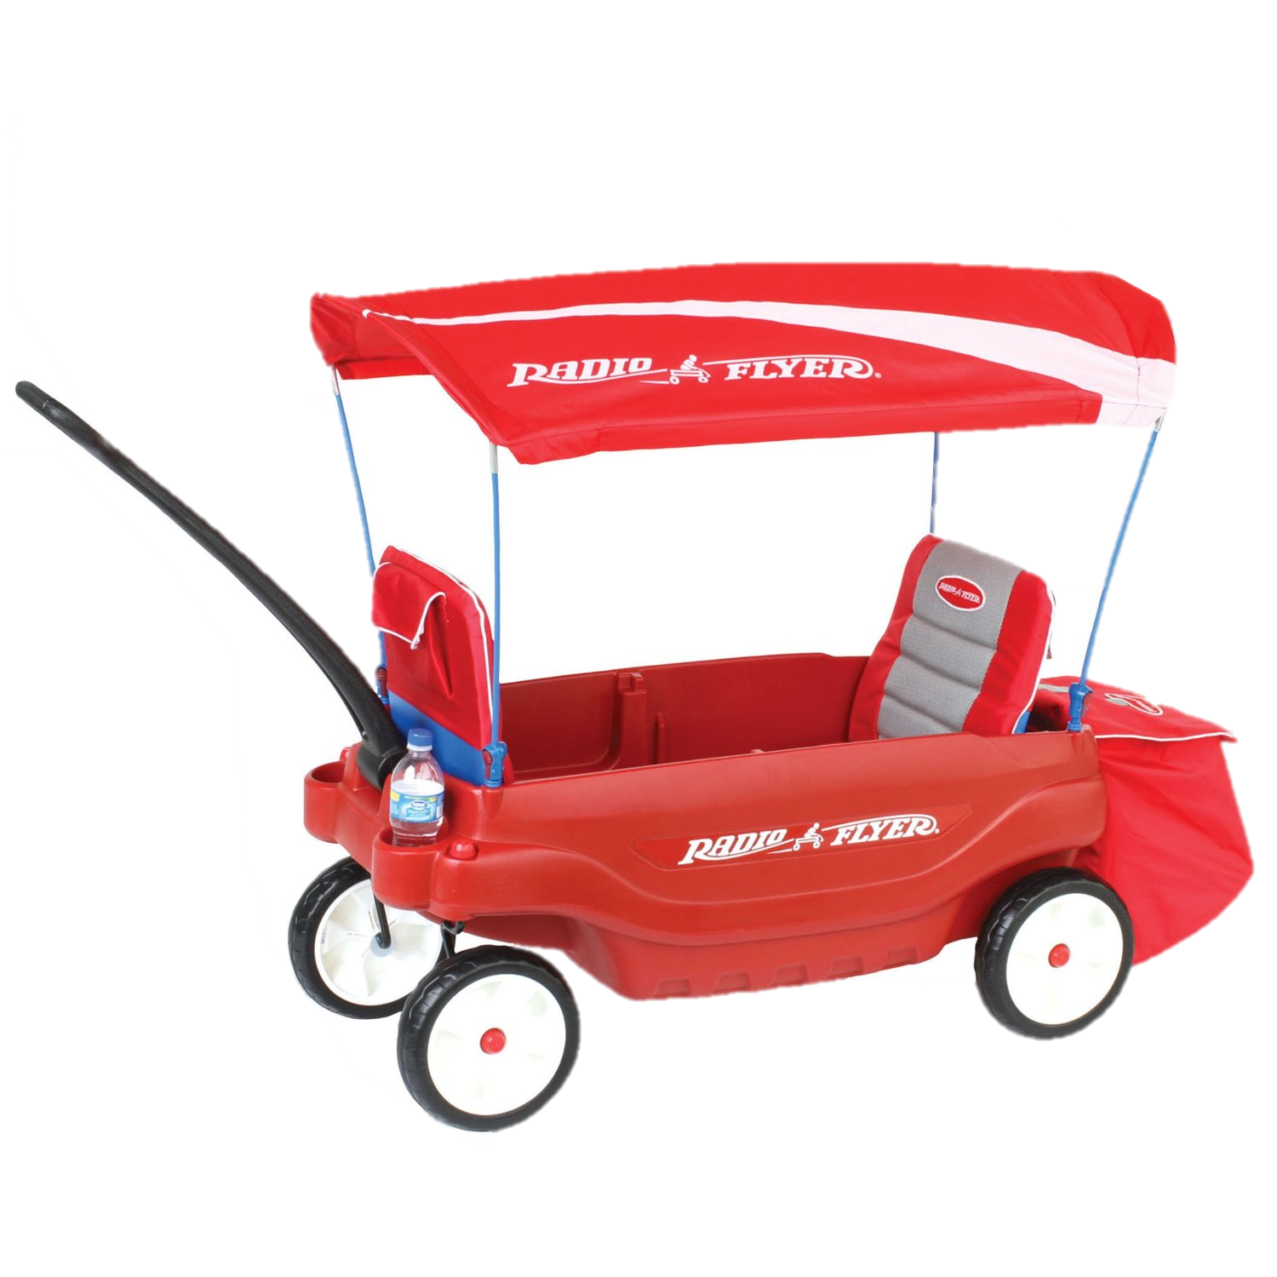
Motivation & Solution
Draggable
It can be dragged around like a wagon.

Slide 10
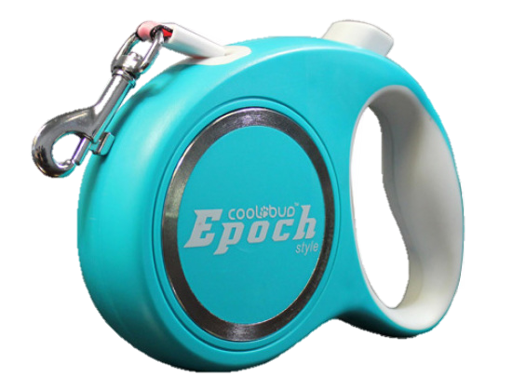
Adjustable length using tension
It will be able to adjust the length of the rope using the same structure as the pet lead.

Slide 11
Determine direction using string angle
Constant length and tension
cart

Slide 12
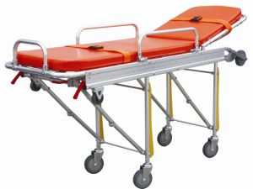
Foldable legs
If you put a cart in your car, you can fold the its legs like medical stretcher.

Slide 13
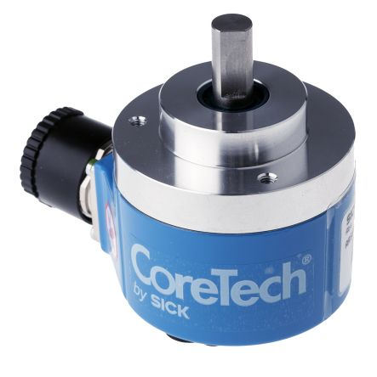
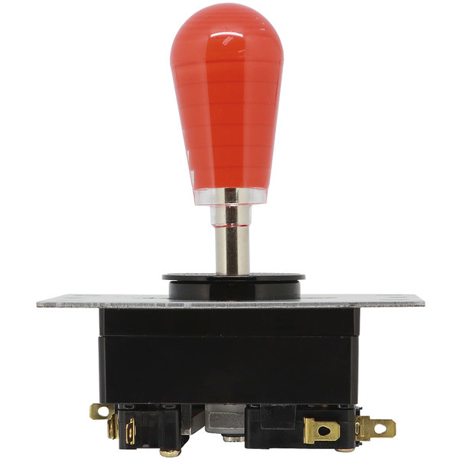
Determine direction using string
By using the absolute encoder and the variable resistor which is the principle of the joystick, it is possible to determine the direction of the robot by recognizing the direction of the string by measuring the angle.

Slide 14
Hardware

Slide 15
Hardware
Main body
Wheels part
String part
Foldable structure
Absolute Encoder
angle
Motor control
BLDC Motor control
tension
length
Incremental Encoder

Slide 16
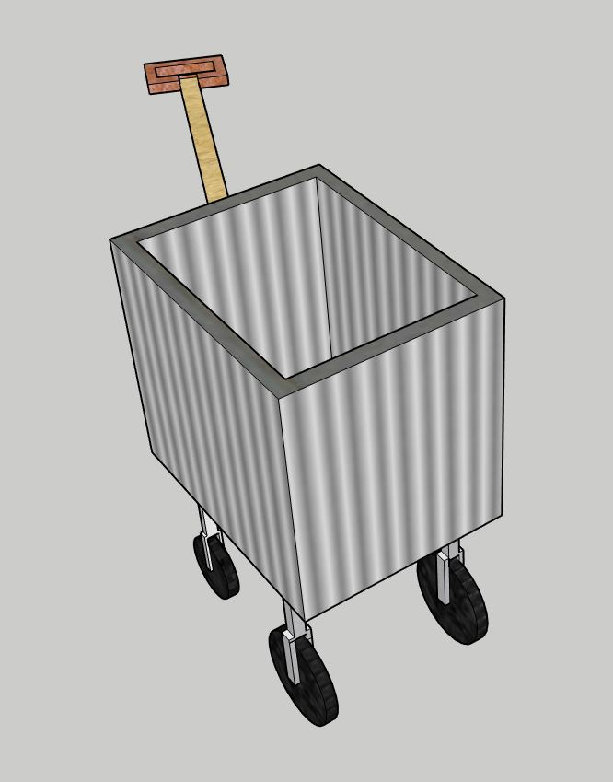
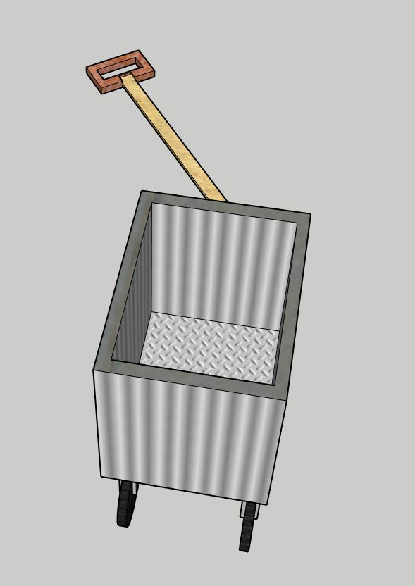
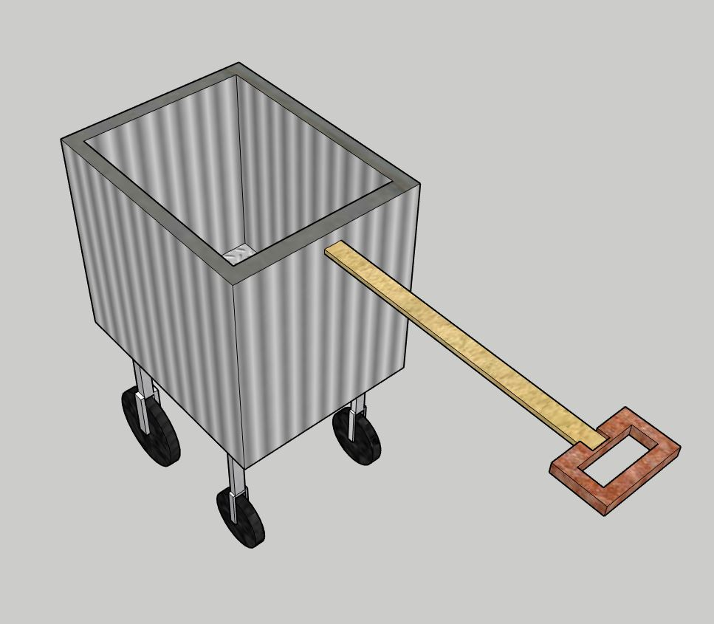
Move forward
Turn right
Turn left

Slide 17
Team & Solution

Slide 18
Team & Schedule
Wheels control
Woo Jae, Min ho
Shopping cart
String control
Myeong Jae, Hyeon ah

Slide 19
 | May |  |  |  | April |  |  |  | March |  |  |  | June
Hardware configuration
BLDC Motor control with absolute encoder
BLDC Motor control with incremental encoder
String motor control with incremental encoder
String motor control with absolute encoder
Test and error correction

Slide 20
Thank you!

